Slide 1
Illumina Team
Opentron Workflow

Slide 2
Input Sample QC- BR dsDNA
OPENTRONS
Master mix
Reservoir
Thermofisher
199ul/well
EMPTY PLATE (96 WELL)
BLACK NUNC PLATE
6 cycles of Mixing
2mins Incubation in Dark
Clariostar
SAMPLE PLATE (from Biobank) (96 WELL)
HSP
1ul/well
Prepare EXCEL sheet

Slide 3
PRE LIBRARY PREP NORMALIZATION
OPENTRONS
RSB
Reservoir
Thermo-
fisher
Volume based on EXCEL sheet
EMPTY PLATE (96 WELL)
Semi-skirted
Total vol: 25uL
Mixing
NORMALIZED PLATE (96WELL)
SAMPLE PLATE (from Biobank) (96 WELL)
HSP
Volume based on EXCEL sheet

Slide 4
Library QC-HS ssDNA
OPENTRONS
Master mix
Reservoir
199ul/well
EMPTY PLATE (96 WELL)
6 cycles of Mixing
2mins Incubation in Dark
Clariostar/ Qubit
LIBRARY PLATE (MANUAL/AUTOMATION (96 WELL)
1ul/well
Prepare EXCEL sheet

Slide 5
LIBRARY NORMALIZATION
OPENTRONS
RSB
Reservoir
Themo-
fisher
Volume based on EXCEL sheet
2.5 nM Concentration_EMPTY PLATE (96 WELL)
SEMI SKIRTED
TOTAL VOL: 25uL
Mixing
NORMALIZED PLATE (96WELL)
LIBRARY PLATE (MANUAL/AUTOMATION (96 WELL)
SEMI-SKIRTED
Volume based on EXCEL sheet

Slide 6
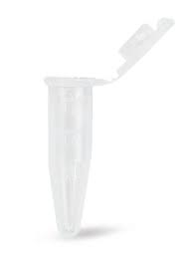
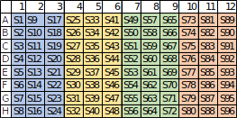
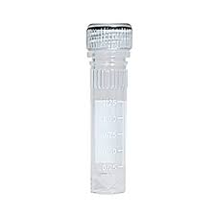
LIBRARY POOLING &DILUTION
OPENTRONS
POOL 15 uL OF NORMALIZED LIBRARIES (2.5nM) INTO A SINGLE TUBE
HSP
S1-S24
S25-S48
S49-S72
S73-S96
310 uL OF POOLED LIBRARIES
Adding 78 uL of 400mM Tris_HCl
Adding 77 uL of 0.2N NaOH
(310 uL of 2.5nM Pool +1.9 uL of 2.5nM PhiX) + 77 uL of 0.2N NaOH
Manual
Transfer to Library Tube
8 min. Incubation
DILUTION TO 2.5nM PhiX
DILUTION TO 0.2N NaOH
7.5ul NFW +2.5ul PhiX
160 ul NFW + 40 ul NaOH
PhiX 10nM
2.5nM of PhiX
0.2N NaOH
PhiX 1N NaOH

